Slide 2
Azure Durable Functions for serverless .NET orchestration
Jeff Hollan

Slide 3

About Me….
Senior Program Manager for Azure Functions
Original member of the “Azure Serverless” team
Knew .NET was my true love when using to create my first Windows Phone app in 2013.
@jeffhollan
https://medium.com/@jeffhollan

Slide 4
Learning Objective
Understand where Serverless and Durable Functions may fit

Slide 5


What is serverless?
Full abstraction of servers
Developers can just focus on their code—there are no distractions around server management, capacity planning, or availability.
Instant, event-driven scalability
Application components react to events and triggers in near real-time with virtually unlimited scalability; compute resources are used as needed.
Pay-per-use
Only pay for what you use: billing is typically calculated on the number of function calls, code execution time, and memory used.*
*Supporting services, like storage and networking, may be charged separately.

Slide 6

Focus on code, not plumbing
No infrastructure management
Auto-scale based on your workload
No wasted resources, pay only for what you use

Slide 7
FaaS is at the center of serverless Functions-as-a-Service programming model use functions to achieve true serverless compute
Single responsibility
Functions are single-purposed, reusable pieces of code that process an input and return a result
Short lived
Functions don’t stick around when finished executing, freeing up resources for further executions
Stateless
Functions don’t hold any persistent state and don’t rely on the state of any other processes
Event driven & scalable
Functions respond to predefined events, and are instantly replicated as many times as needed

Slide 8


Boost development efficiency
Trigger object
Your code
Input object
Input Binding
Output object
Trigger
Output Binding
Notes:
There is a lot of code you can save thanks to the Functions programming model based on triggers and bindings, as this code to connect to different services (either for trigger data and input/output operations) is done by the platform, improving your development time as you don’t lose a minute on connections code that tend to be reused a lot of times.
See the full list of services with Triggers and bindings – https://docs.microsoft.com/en-us/azure/azure-functions/functions-triggers-bindings

Slide 9
What if my task isn’t short lived, simple, and stateless?

Slide 10
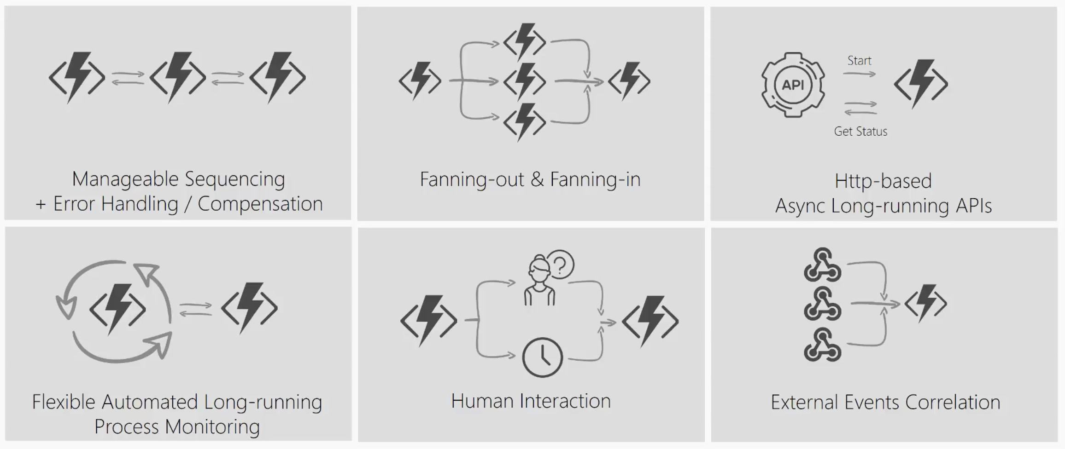
What’s still hard?
Notes:
Imagine a scenario where I have to take the output of a Function and use it as the input to call another Function. I’ll have to coordinate the chaining manually.
If I have to have a function that takes some sort of event and then parallelizes it into multiple Functions, I can still do that but how will I know when all Functions have finished executing so I can aggregate the results and move on.
What if I had to listen on multiple events and aggregate their outcome to determine which specific job or function to run in my application.
What if I wanted to do some kind of extended monitoring on an endpoint? For example, if I were to monitor the temperature of a remote machine and take action x if the temperature were lower than a certain threshold, else do y or run job y.
What if I have an API or endpoint that was running for a long time? I know Functions are short-lived but sometimes you guys put some serious load on them. Could there be a mechanism to provide status of the execution back to the client so they’re not left hanging?
And lastly, what if I wanted to get some sort of human interaction in there? For example, if I am to do some sort of 2FA in the middle of my function execution but also don’t want to wait forever because sometimes people take forever to reply especially when the texts are automated.
Today, I’m going to be talking about some of these problems – how you can approach them in regular FaaS? And how they can be simplified with the technology of Durable Functions.

Slide 11
Introducing Durable Functions
Write long-running orchestrations as a single function while maintaining local state.
Simplify complex transactions and coordination (chaining, etc.) Easily call a Function from another Function, synchronously or asynchronously.
All of the above using code-only. No JSON schemas. No graphical designer.
Generally available (v1). Supports multiple languages (C#, JavaScript)
Notes:
Durable Functions is an advanced feature of Azure Functions. They provide the ability to write long running orchestrations using a single function while still being able to maintain a global state.
Durable highly simplifies some of the scenarios that we saw in the previous slides by making it easy to implement scenarios such as chaining, fan out / fan in , etc.
While still being able to use your beloved code constructs. You don’t have to conform to an JSON schemas or adopt any graphical workflow designers.
So let’s take a look at what it means to use Durable Functions ….. with some real world problems or patterns ->

Slide 12
Introducing Durable Functions
Write long-running orchestrations as a single function while maintaining local state.
Simplify complex transactions and coordination (chaining, etc.) Easily call a Function from another Function, synchronously or asynchronously.
All of the above using code-only. No JSON schemas. No graphical designer.
Generally available (v1). Supports multiple languages (C#, JavaScript)
Notes:
Durable Functions is an advanced feature of Azure Functions. They provide the ability to write long running orchestrations using a single function while still being able to maintain a global state.
Durable highly simplifies some of the scenarios that we saw in the previous slides by making it easy to implement scenarios such as chaining, fan out / fan in , etc.
While still being able to use your beloved code constructs. You don’t have to conform to an JSON schemas or adopt any graphical workflow designers.
So let’s take a look at what it means to use Durable Functions ….. with some real world problems or patterns ->

Slide 13
Components
Starter
Function
Orchestrator Function
Activity Function
Activity Function
Activity Function
Starts orchestrations
Coordinates activities
Performs work
OrchestrationClient
OrchestrationContextTrigger
ActivityTrigger

Slide 14
What It Looks Like
Orchestrator Function
// calls functions in sequence
public static async Task<object> Run(DurableOrchestrationContext ctx)
{
try
{
var x = await ctx.CallFunctionAsync("F1");
var y = await ctx.CallFunctionAsync("F2", x);
return await ctx.CallFunctionAsync("F3", y);
}
catch (Exception)
{
// global error handling/compensation goes here
}
}
Activity Functions
Notes:
> So in Durable Functions, we introduce the concept of “an orchestrator" that will orchestrate or manage what happens between rest of the Functions.
> It is responsible for calling and receiving output from activity functions that you’re familiar with as regular functions. When an activity returns, it return value becomes part of the local state of the orchestrator function so you’re able to work with it as any other variable in that block of code.
> CallFunctionAsync uses queues under the covers, thus they can be scaled out to multiple VMs.
The other thing is that if I want to have exceptions in my code, say something goes wrong in a particular function, I can do that. We’re all familiar with the syntax and now we can do it in a distributed way.
Mention rewind feature to talk about in new developments

Slide 15
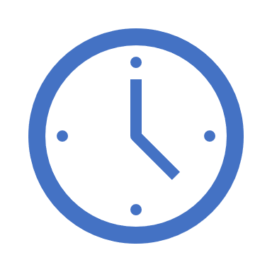

var outputs = new List<string>();
outputs.Add(await context.CallActivityAsync<string>("SayHello", “.NET Conf"));
return outputs;
History Table
Orchestrator Function
Orchestrator Function
Activity Function
Orchestrator Started
Activity Function
Execution Started
Task Scheduled, SayHello, “.NET Conf”
Orchestrator Completed
[“Hello .NET Conf!”]
“Hello .NET Conf!”
“Hello .NET Conf!”
Task Completed, “Hello .NET Conf!”
?
Orchestrator Started
Execution Completed, ["Hello .NET Conf!"]
Orchestrator Completed
Execution History
Notes:
Grasping how orchestrators use execution history to replay and rebuild their local state is key to understanding how Durable Functions works, so let’s walk through the execution of a simple orchestrator function.
The light blue box at the top of the slide is the orchestrator’s code.
“SayHello” our activity function, which returns “Hello” and whatever input you give it.
Our execution history is currently empty. As we start to record events, they’ll show up here. (Indicate area.)
1. A request is made to the orchestrator function.
2. The orchestrator starts and begins executing until it’s asked to await some async work. In this case, we want to call an activity function.
3. The orchestrator checks the execution history for a record of the activity function.
4. There’s no record of the activity function being called or completed, so the orchestrator schedules that work.
5. While the orchestrator waits on work to complete, it shuts down.
5. The scheduled activity function runs.
6. A record of this is added to the execution history. In this case we produced output, so that’s stored.
7. Now the orchestrator has more work to do. It restarts and executes its code **from the beginning** to build up its local state.
8. As before, the orchestrator executes until it reaches an await.
9. The orchestrator checks the execution history. This time there’s a record of the async work being done.
10. The activity function’s stored output is passed back to the orchestrator. In this case, the value is added to a list of strings.
11. The orchestrator continues executing. In a more complex orchestrator with multiple await calls, the checkpoint, schedule and replay steps would repeat for each one. This orchestrator runs to completion and returns its output.
12. And we’re done!
- How does the framework know to wake up

Slide 16
Durable Hello World

Slide 17
Orchestrator Constraints
Orchestrator code must be deterministic
Never use random numbers, DateTime.UtcNow, Guid.NewGuid(), etc.
Use DurableOrchestrationContext.CurrentUtcDateTime
Never do I/O directly in the orchestrator
Do I/O in activity functions
Don’t write infinite loops
Use DurableOrchestrationContext.ContinueAsNew()

Slide 18
Durable Fan-Out / Fan-In

Slide 19

eShop Report Generator
Request Report
HTTP GET
Orders DB
For Each Order
Check Status
Shipping APIs

Slide 20
More Information
Documentation: https://aka.ms/durablefunctions
GitHub:
https://github.com/Azure/azure-functions-durable-extension
https://github.com/Azure/durabletask/tree/azure-functions
Twitter:
@AzureFunctions
@cgillum
@kashimizMSFT
@ling_toh

Slide 22

Durable Functions vs Logic Apps
Both allow implementing advanced workflow patterns.
C#, F# and JavaScript | Visual Designer
~20 Bindings | 200+ Connectors
Portable runtime | Runs only on Azure
Monitoring based on App Insights and APIs | Rich monitoring and management tools
Serverless, dedicated and isolated | Serverless only
Stateful Replays | Queued Dependency Graph
Notes:
At the end of the day, both durable functions and logic apps have their benefits. From speaking with several customers, we’ve realized that which one you choose is simply a matter of individual preference.
Logic Apps is a big product itself with several features of its own so I wont dive into too much detail about that here but feel free to stop by our booth to see some demoes and get more information.
Logic Apps can run Durable Functions! You can hook them into your Logic Apps workflows.

Slide 23
Code Sample Title

